Slide 1
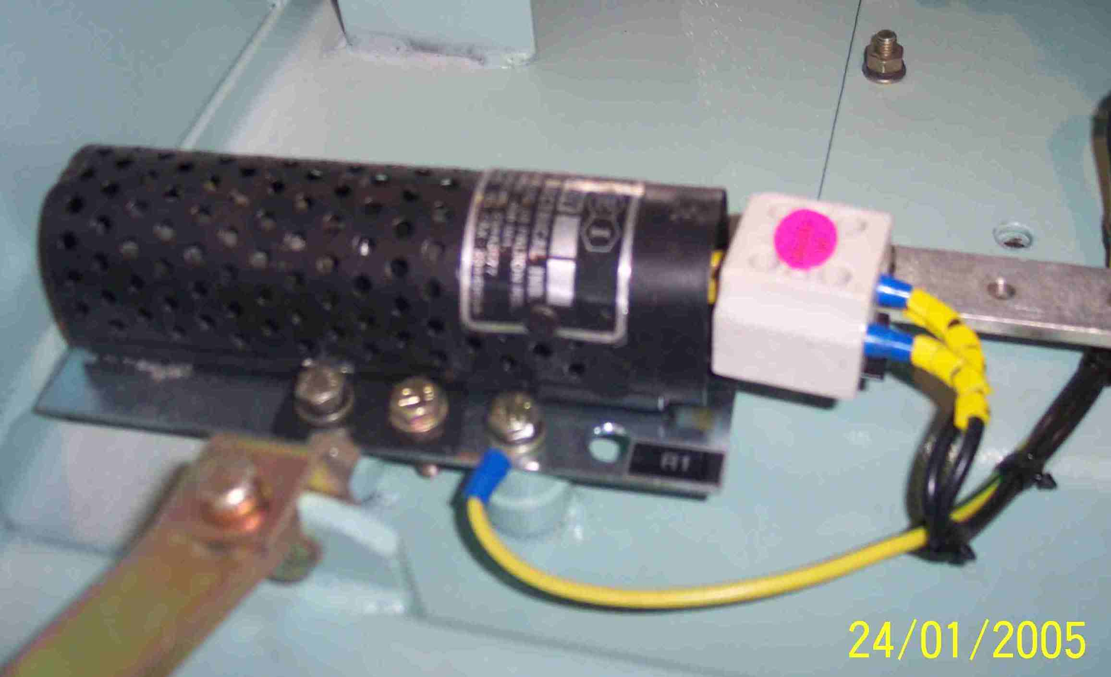
SIEMENS
HVCB SPARES
Space Heater
72.5KV, 145KV & 245KV CB
S4799032501

